Slide 1
Civita Laurea Project
The Effects of Supervised Modeling and Unsupervised Hierarchical Clustering for Topic Clustering as They Apply to Educational Videos on Mathematics
Ziming Wang
Idaho State University

Slide 2
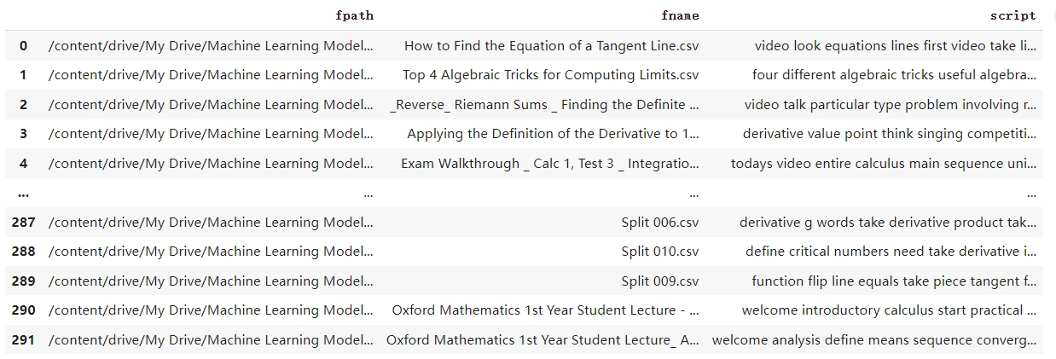
Nature Language Processing
Topic Modeling
Unsupervised learning
Classification of each document
No pre-labeled training examples are given
Each document contains multiple topics.
Each topic contains multiple words.

Slide 3
Topic Modeling
Bidirectional Encoder Representations from Transformers (BERT) model
Pre-trained context representation learning.
Take into account the context in which words appear.
Add masks to the beginning and ending of a sentence.
Too many masks affect the performance of model.

Slide 4
keyBERT
Document Keywords
Differentiates individual scripts from their clusters
Only the top 20 topics with math keywords are accepted
Advantages of keyBERT:
Pretrained model with a high accuracy
Flexibility depending on use case
Semantic understanding using the BERT model

Slide 5
Before keyBert

Slide 6
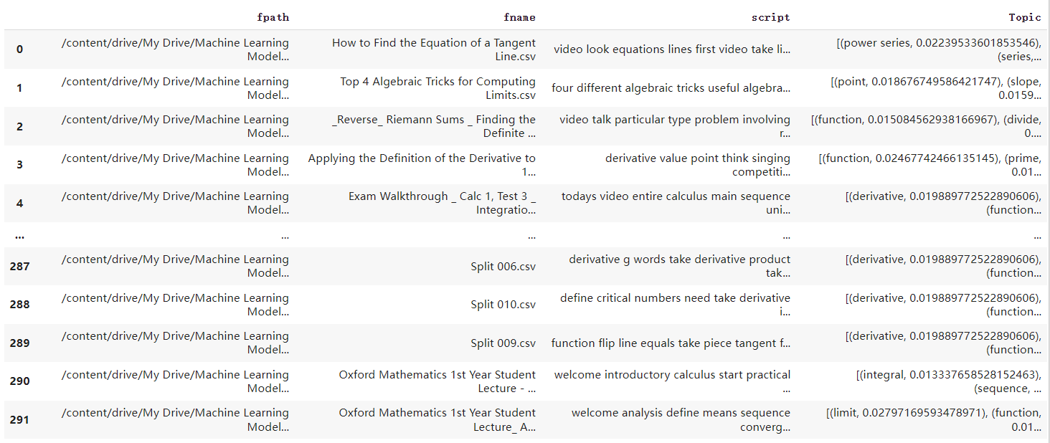
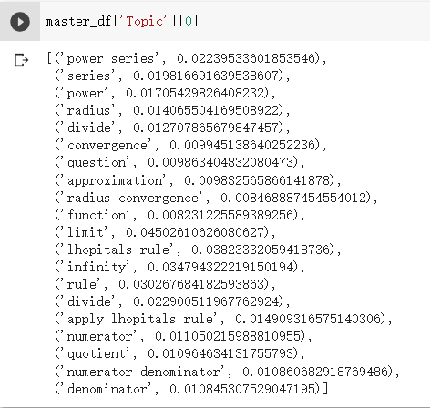
After keyBERT

Slide 7
Classify the Scripts
Separating scripts into predetermined categories
Supervised Model
-XGBoost
Class Style
-Theoretical
-Applied
Class Subject
-Precalculus
-Calculus

Slide 8
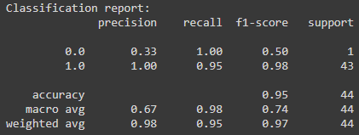
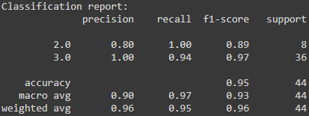
XGBoost Model
Remove 10% frequency words
Handle the imbalance of our data
Applied: 5%; Theoretical: 95%; Calculus: 78%; Precalculus: 22%
Pad our data by using SMOTE tool
95.5% accuracy for both style and subject
Precision, recall, and f1 score
Figure 1: teaching style classification report
Figure 2: subject classification report

Slide 9
BERTopic Model
Create keywords and cluster similar documents
BERT embedding and class-based TF-IDF for clusters
Sentence Transformers
Use UMAP and the HDBSCAN
c-TF-IDF

Slide 10
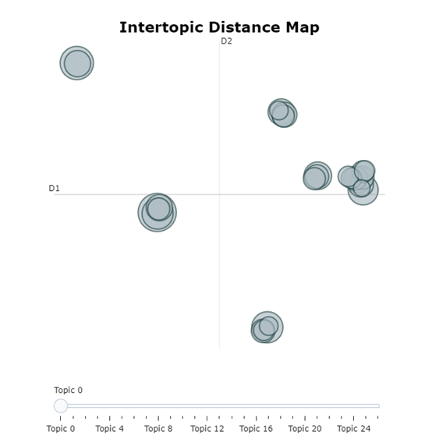
BERTopic Model
umap
hdbscan
Hierarchical Clustering
BERTopic parameters
N-grams
Number of keywords
Calculate probabilities
Language
Umap model
Hdbscan model

Slide 11
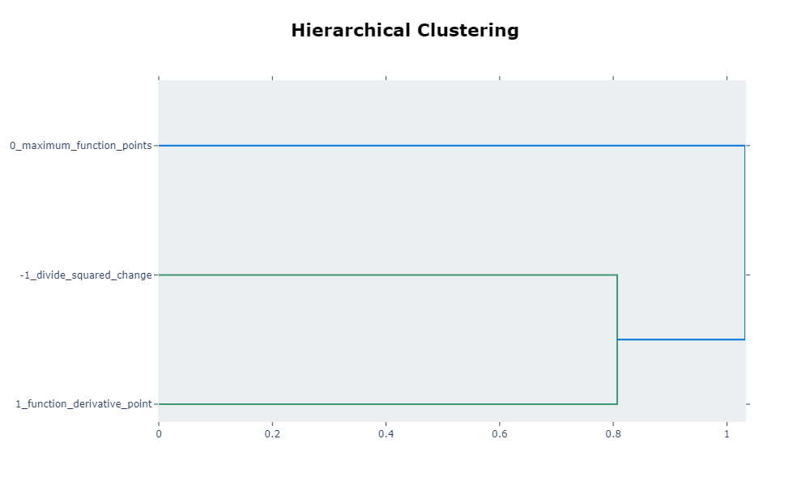
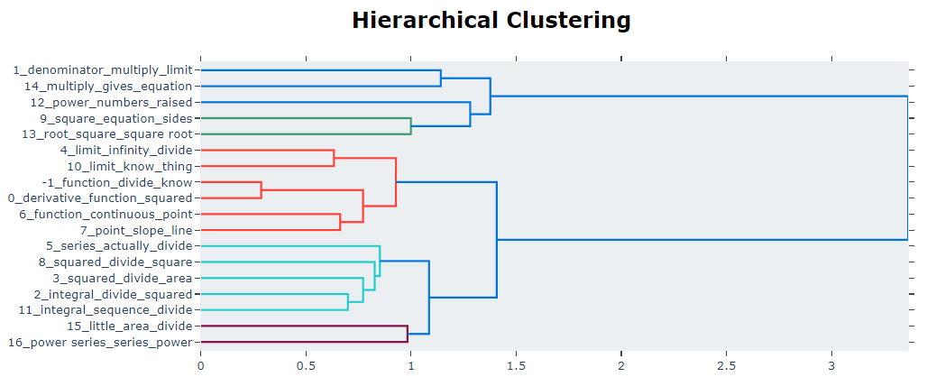
BERTopic Model Hierarchical Clustering
Figure 1: Applied
Figure 2: Theoretical

Slide 12
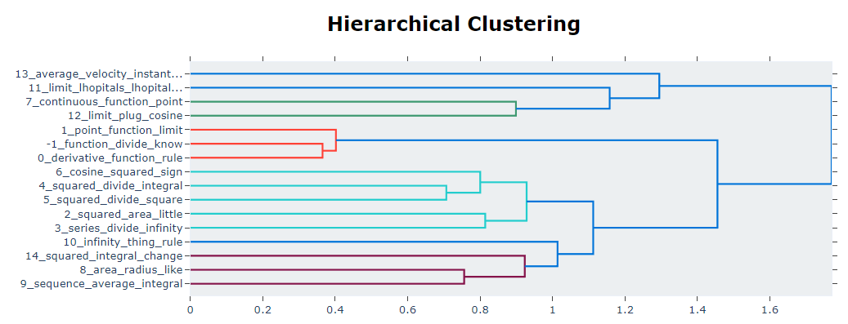
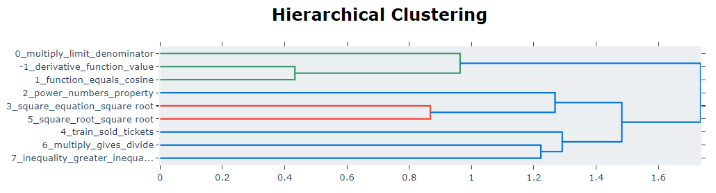
BERTopic Model Hierarchical Clustering
Figure 3: Calculus
Figure 4: Precalculus

Slide 13
Processing Pipeline
Clean Scripts
Removing stopwords
Top 1% of most common words in corpus removed (BERTopic model only)
Numbers and Symbols to words
Removing disclaimers
Removing words of 3 or less characters
Lemmatize words (XGBoost model only)
Classify videos into predefined category groups
Class Style (Theoretical or Applied)
Class Subject (Precalc or Calc)
XGBoost model used with SMOTE to account for data imbalance

Slide 14
Processing Pipeline
Individual Labeling
keyBERT model used
Top 5 keywords assigned to scripts
Hierarchical Clustering
Each partition from the XGBoost model are clustered
Unsupervised method using BERTopic model
umap, hdbscan, BERT
Collate results into one dataframe

Slide 15
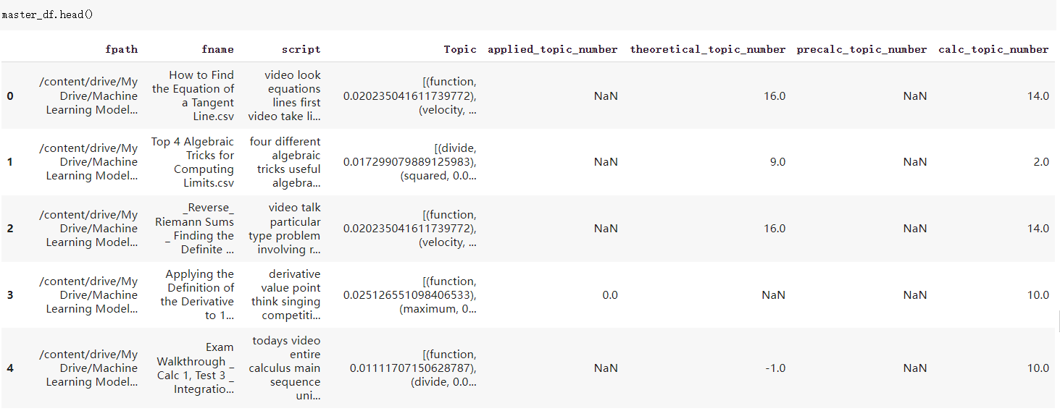
Final results

Slide 16
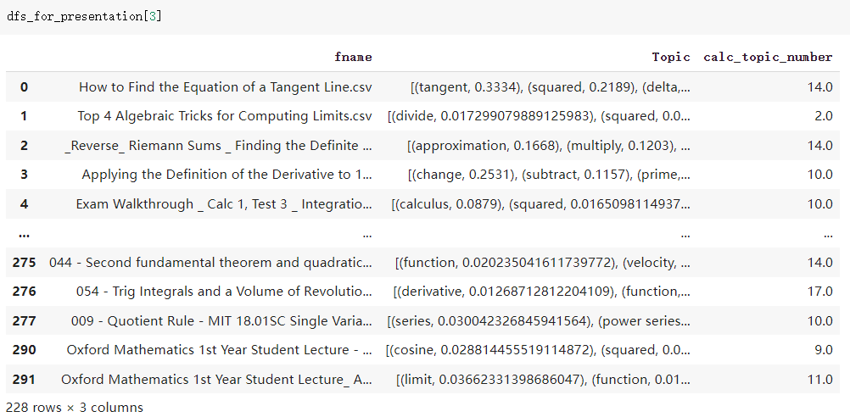
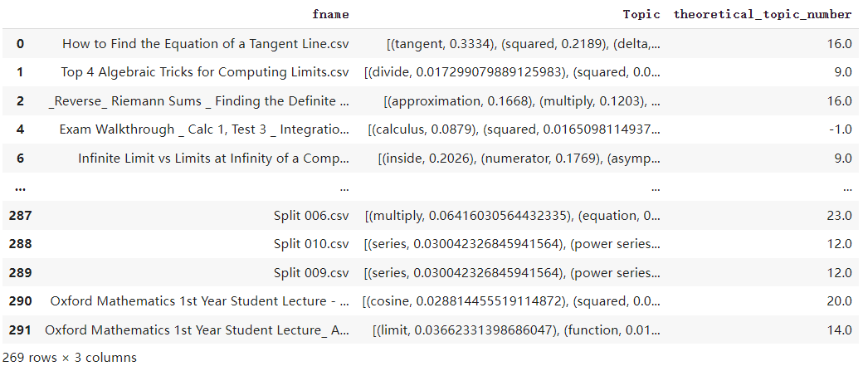
Final results
Calculus
Theoretical

Slide 17
Acknowledge
Project Provider: Laura Sánchez Fernández, Civita Laurea, Canada
Project advisor: Dr. Xiaoxia Xie, Idaho State University
Co-author: David Lindeman, Idaho State University
Thank you!

